Slide 1
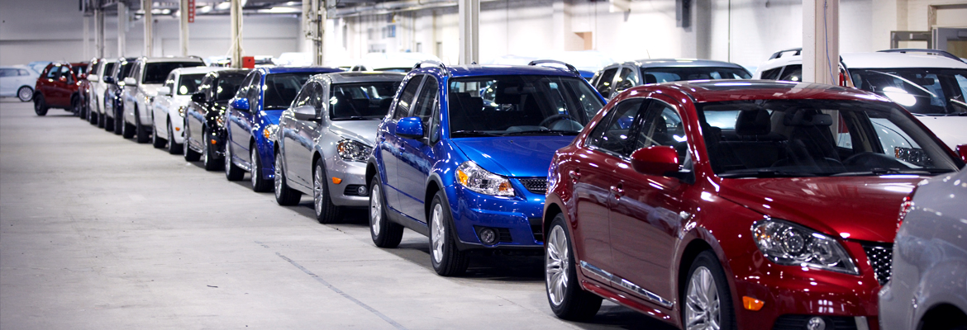
VEHICLE MANAGEMENT SYSTEM
Malav Shah - 201812021
Zeel Modi - 201812022
Mohit Tanwani - 201812023
Neeta Kumari - 201812024

Slide 2
Functional Requirements
Vehicle owners can view their vehicle service and maintenance history.
Service providers can view their all customer records for their branch.
Service providers can view their all employee records for their branch.
Service provider can search vehicle based reports.
Staff management for service provider
Which payment method customers are most likely to use.
Which vehicle had required maximum time for service.

Slide 3
Database Model
ER Model
Relational Model

Slide 4
Top Functional Requirements

Slide 5
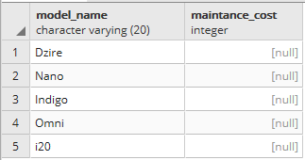
Retrieve which vehicle model requires least maintainance than other vehicle models for particular vehicle type.
select vm.model_name,t2.average_cost as maintance_cost from vehicle_mgmt.vehicle_models as vm join (select (t1.smc/t1.nvr)::integer as average_cost,t1.mid as model_id,t1.nvr as no_of_v from (select sum(eg.no_of_vehicles_registered) as nvr,sum(eg.no_of_time_it_requires_service) as nrs ,sum(eg.sum_of_maintance_cost) as smc,eg.model_id as mid from (select count(df.vid) as no_of_vehicles_registered,df.c2 as no_of_time_it_requires_service,df.c3 as sum_of_maintance_cost,df.mid as model_id from (select vv.vehicle_id as vid,(select count(*) from vehicle_mgmt.services as ss where ss.vehicle_id=vv.vehicle_id)as c2, (select sum(pp.amount) from vehicle_mgmt.payments as pp join vehicle_mgmt.services as ss on ss.pay_id=pp.pay_id where ss.vehicle_id=vv.vehicle_id) as c3, vm.model_id as mid from vehicle_mgmt.vehicles as vv join vehicle_mgmt.vehicle_models as vm on vv.model_id=vm.model_id join vehicle_mgmt.vehicle_types as vt on vm.type_id=vt.type_id where vt.type_name='Car') as df group by mid,df.c2,df.c3) as eg group by eg.model_id) as t1)as t2 on t2.model_id=vm.model_id order by case when t2.average_cost is null then 0 else 0 end,maintance_cost desc nulls first LIMIT 5

Slide 6
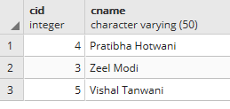
List all the customers who had given feedback for all services.
select v1.cid,v3.cname from vehicle_mgmt.vehicles as v1 join (select t1.vid as vehcle_id from (select count(j2.feed_id) as cnt1,j1.vehicle_id as vid from vehicle_mgmt.services as j1 join vehicle_mgmt.feedbacks as j2 on j2.service_id=j1.service_id group by j1.vehicle_id) as t1 join (select count(cnt2.service_id) as cnt2,cnt2.vehicle_id as vid from vehicle_mgmt.services as cnt2 group by cnt2.vehicle_id) as t2 on t1.vid=t2.vid where t1.cnt1=t2.cnt2) as v2 on v1.vehicle_id=v2.vehcle_id join vehicle_mgmt.customers as v3 on v1.cid=v3.cid;

Slide 7
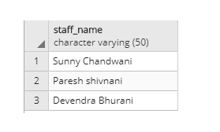
Retrieve top 5 staff details who had maximum ratings in their service feedback for particular vehicle type.
select sd.staff_name from vehicle_mgmt.staff_details as sd where sd.staff_id in (select distinct(hj.gh) as sids from (select ss.staff_id as gh,ff.feed_ratings from vehicle_mgmt.services as ss join vehicle_mgmt.feedbacks as ff on ss.service_id=ff.service_id where ss.vehicle_id IN (select vv.vehicle_id from vehicle_mgmt.vehicles as vv where vv.model_id IN (select vm.model_id from vehicle_mgmt.vehicle_models as vm join vehicle_mgmt.vehicle_types as vt on vm.type_id=vt.type_id where vt.type_name='Car')) order by ff.feed_ratings desc LIMIT 5) as hj);

Slide 8
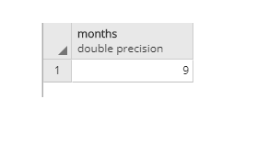
Which service time customer prefers most?
select qq.months from (select count(extract(month from s.entry_time)) as sg,extract(month from s.entry_time) as months from vehicle_mgmt.services as s group by extract(month from s.entry_time) order by sg desc limit 1) as qq;

Slide 9
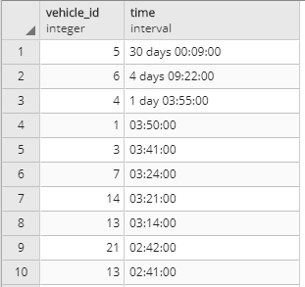
Which vehicle had required maximum time to service.
Select v.vehicle_id,s.exit_time-s.entry_time FROM vehicles as v JOIN services as s on (s.vehicle_id=v.vehicle_id) order by s.exit_times.entry_time desc

Slide 10

THANK YOU
VEHICLE MANAGEMENT SYSTEM

